Slide 1
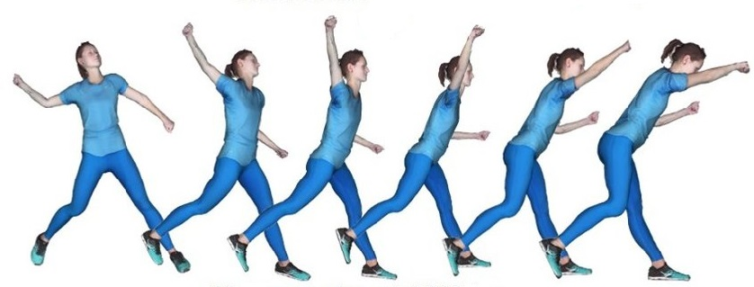
Mastering Recurrent Neural Networks
Theory and Practice in Python
Notes:
1

Slide 2
Focus of the course
Fundamentals
Notes:
2

Slide 3
Focus of the course
Fundamentals
Pythonic
Notes:
3

Slide 4
Focus of the course
Fundamentals
Pythonic
Completeness
Notes:
4

Slide 5
Focus of the course
Fundamentals
Pythonic
Completeness
Recent Models
Notes:
5

Slide 6
Contents
Applications
Deep Learning
RNNs
TensorFlow
Shakespeare
Stock Price Prediction
Future Directions
Notes:
6

